Slide 1
AUTOMATED PCB DEFECT DETECTION
By SATYA SURAJ

Slide 2
INTRODUCTION
PCBs → Heart of every electronic device (mobile, laptop, car, satellite)
Even small manufacturing defects → Device failure + High cost + Safety risk
Traditional methods have serious limitations:
Manual inspection → Slow, tiring, human error
Rule-based AOI → High false positives, misses tiny/complex defects
Growing need for:
Fast & accurate defect detection
Precise location (not just yes/no)
Clear visual output for operators
Project Goal: Build intelligent automated system using Deep Learning (YOLOv8) + Web Interface

Slide 3
Problem Statement & Motivation
PCBs are critical → defects cause failures, cost, safety risks
Common defects: Missing Hole, Mouse Bite, Open Circuit, Short, Spur, Spurious Copper
Limitations
Manual inspection → slow, inconsistent
Rule-based AOI → high false positives, misses subtle defect
Need: Accurate localization + real-time visual feedback

Slide 4
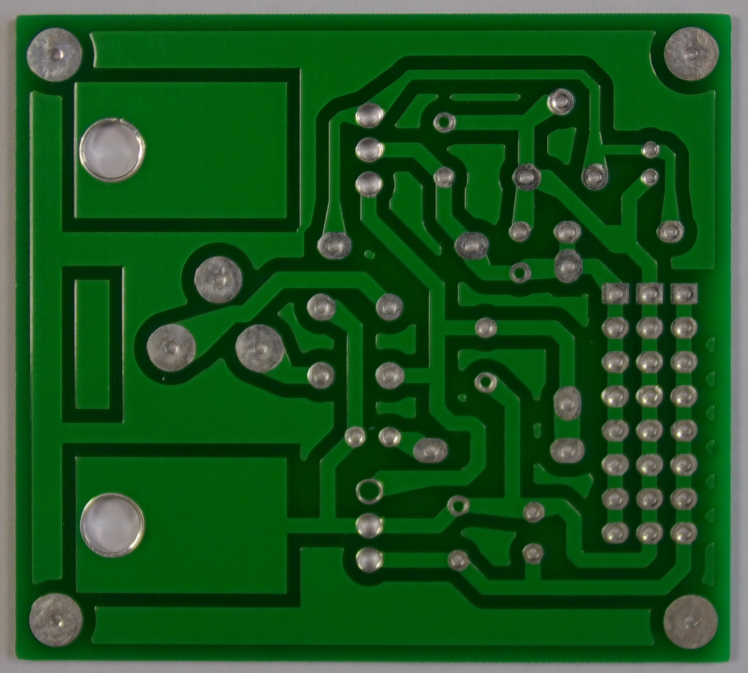
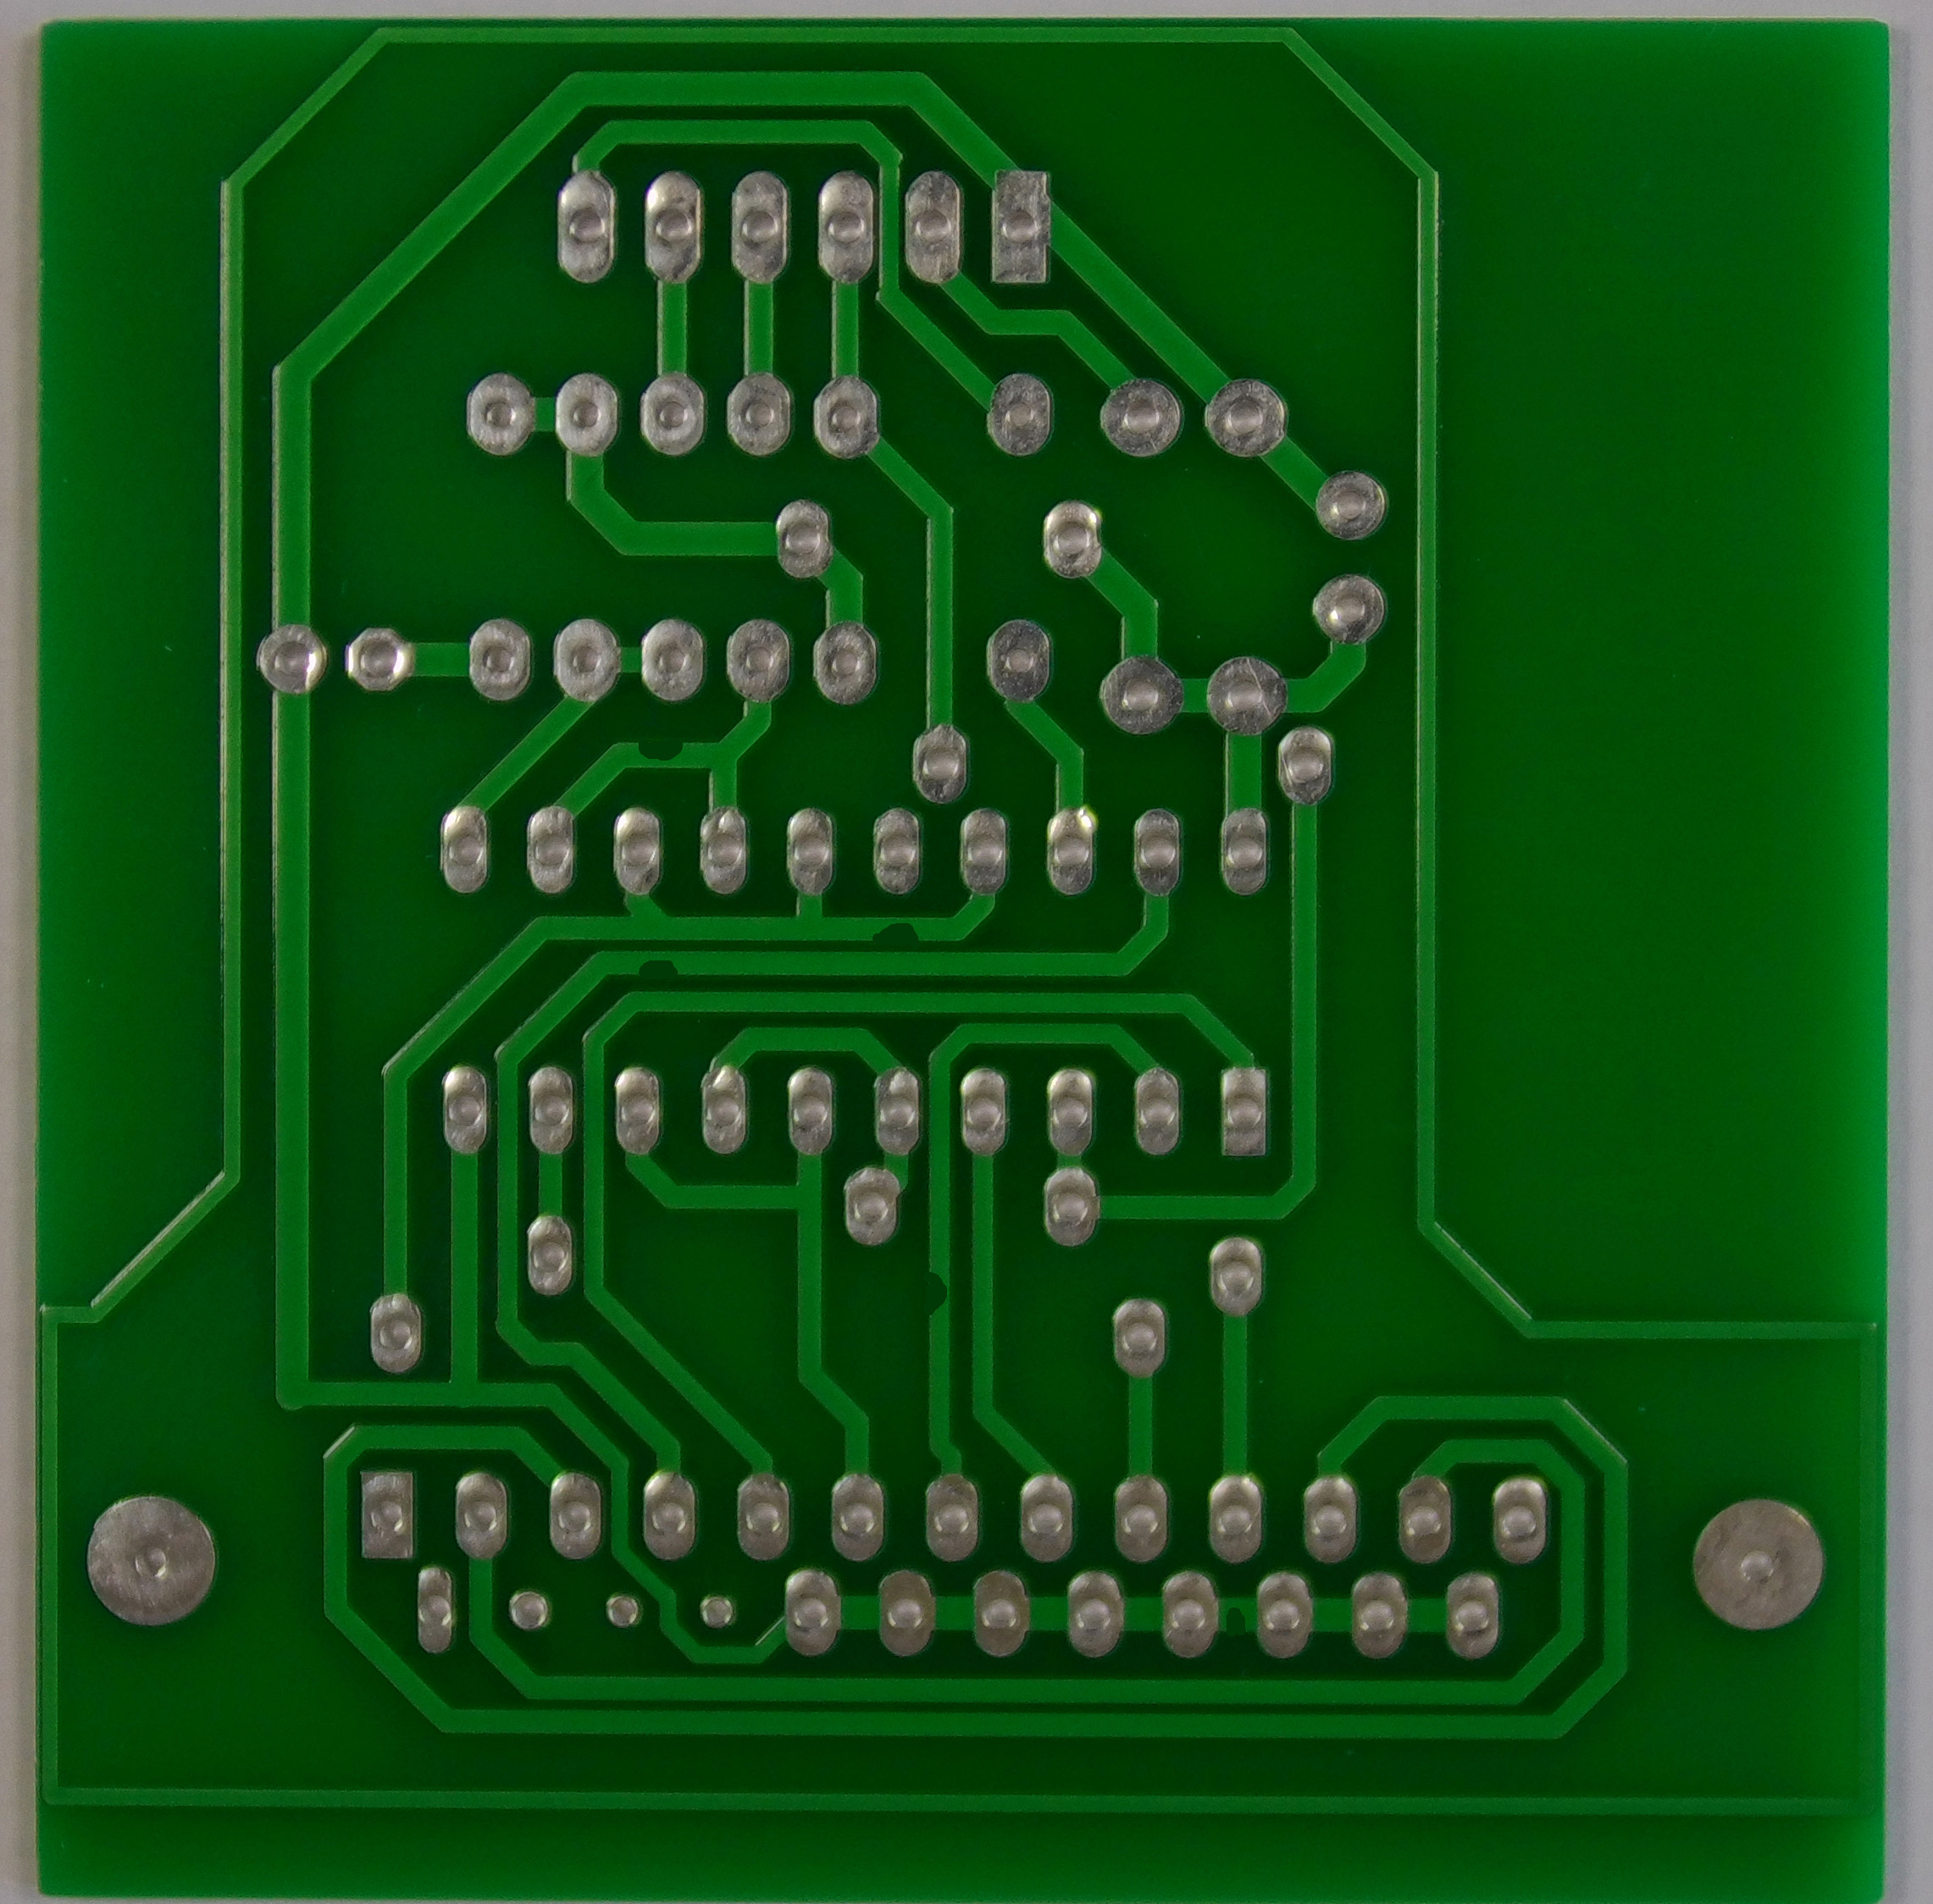

Missed_Hole Mouse_Bite Open _Circuit

Slide 5



Short Spur Spur_Copper

Slide 6
Objectives
Prepare dataset from DeepPCB using subtraction & ROI extraction
Train high-accuracy object detection model (YOLOv8)
Achieve mAP@0.5 > 0.90
Build simple web app for upload → detect → download annotated results
Visual: Bullet icons + small flowchart teaser

Slide 7
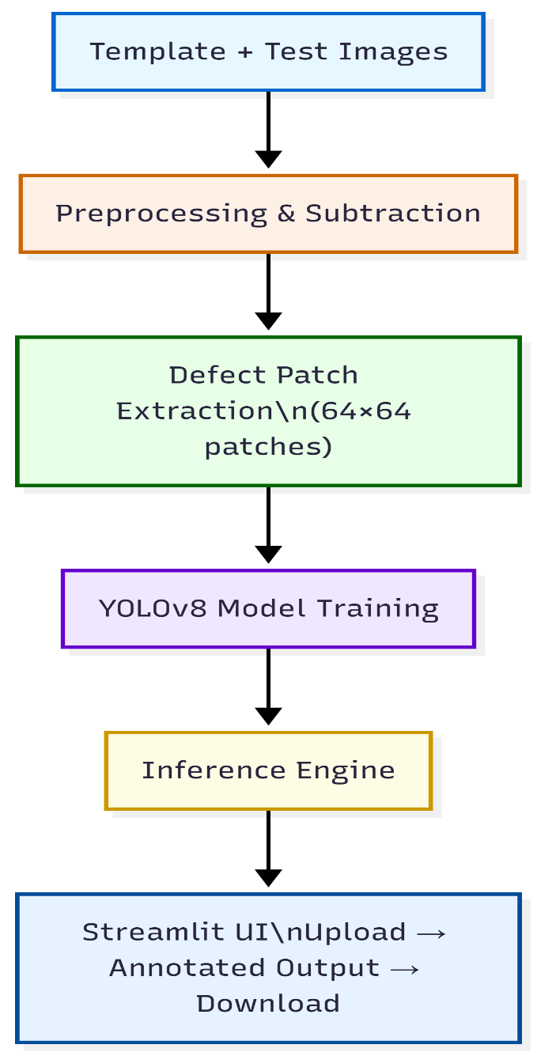
Methodology
System Architecture

Slide 8
Milestone 1 – Dataset Preparation
Dataset: DeepPCB (template-defect pairs)
Module 1: Image subtraction
Grayscale → Resize (1/4) → Gaussian Blur → Adaptive Threshold →
Subtract → Otsu
Module 2: Contour detection & ROI crop
Find contours → Filter area 1–300 → Crop 64×64 around centroid

Slide 9
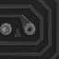
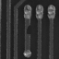
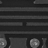
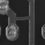
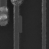

Grey Scale Patches
Missing_Hole Mouse_Bite Open_Circuit
Short Spur Spur_Copper

Slide 10
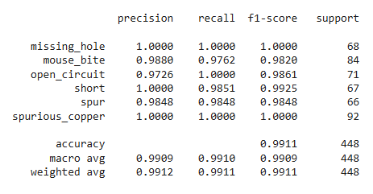
Milestone 2 – Model Training & Evaluation
Switched from EfficientNet to YOLOv8n (better localization & small defects)
Steps:
Combine patches → XML → YOLO labels → Train/val/test split
Train: 80 epochs, batch 16, imgsz=640
Evaluation:
mAP@0.5 ≈ 0.92–0.96

Slide 11
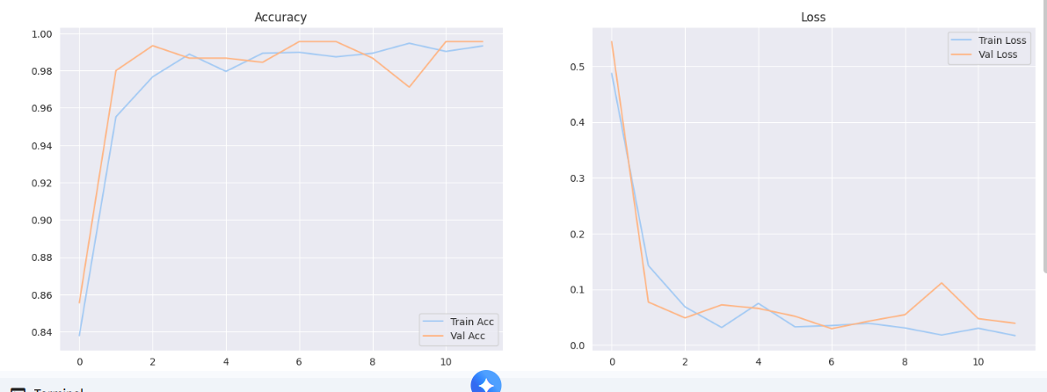

Slide 12
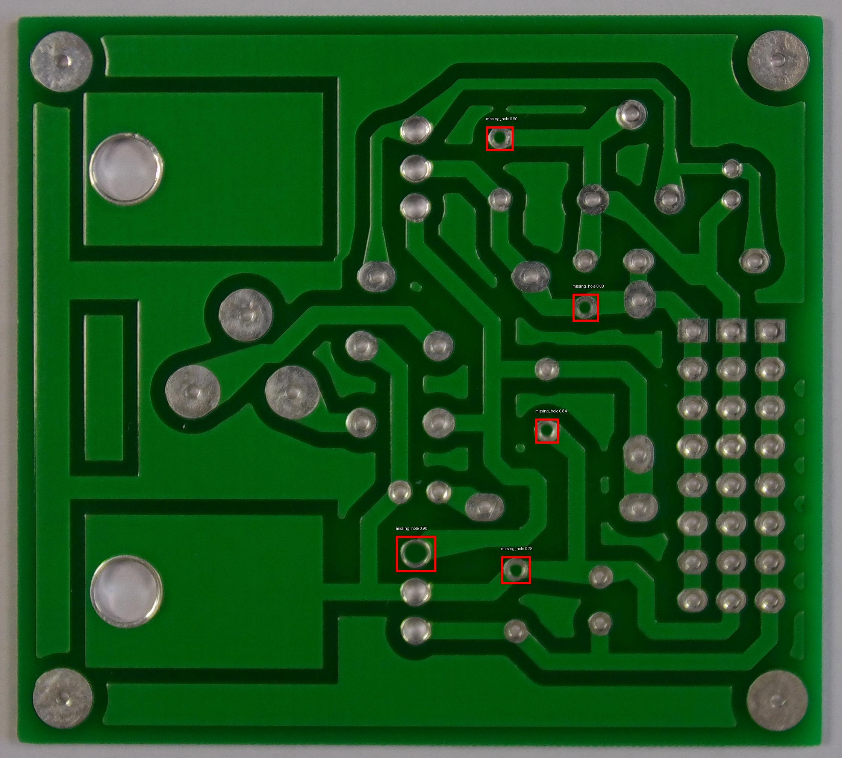
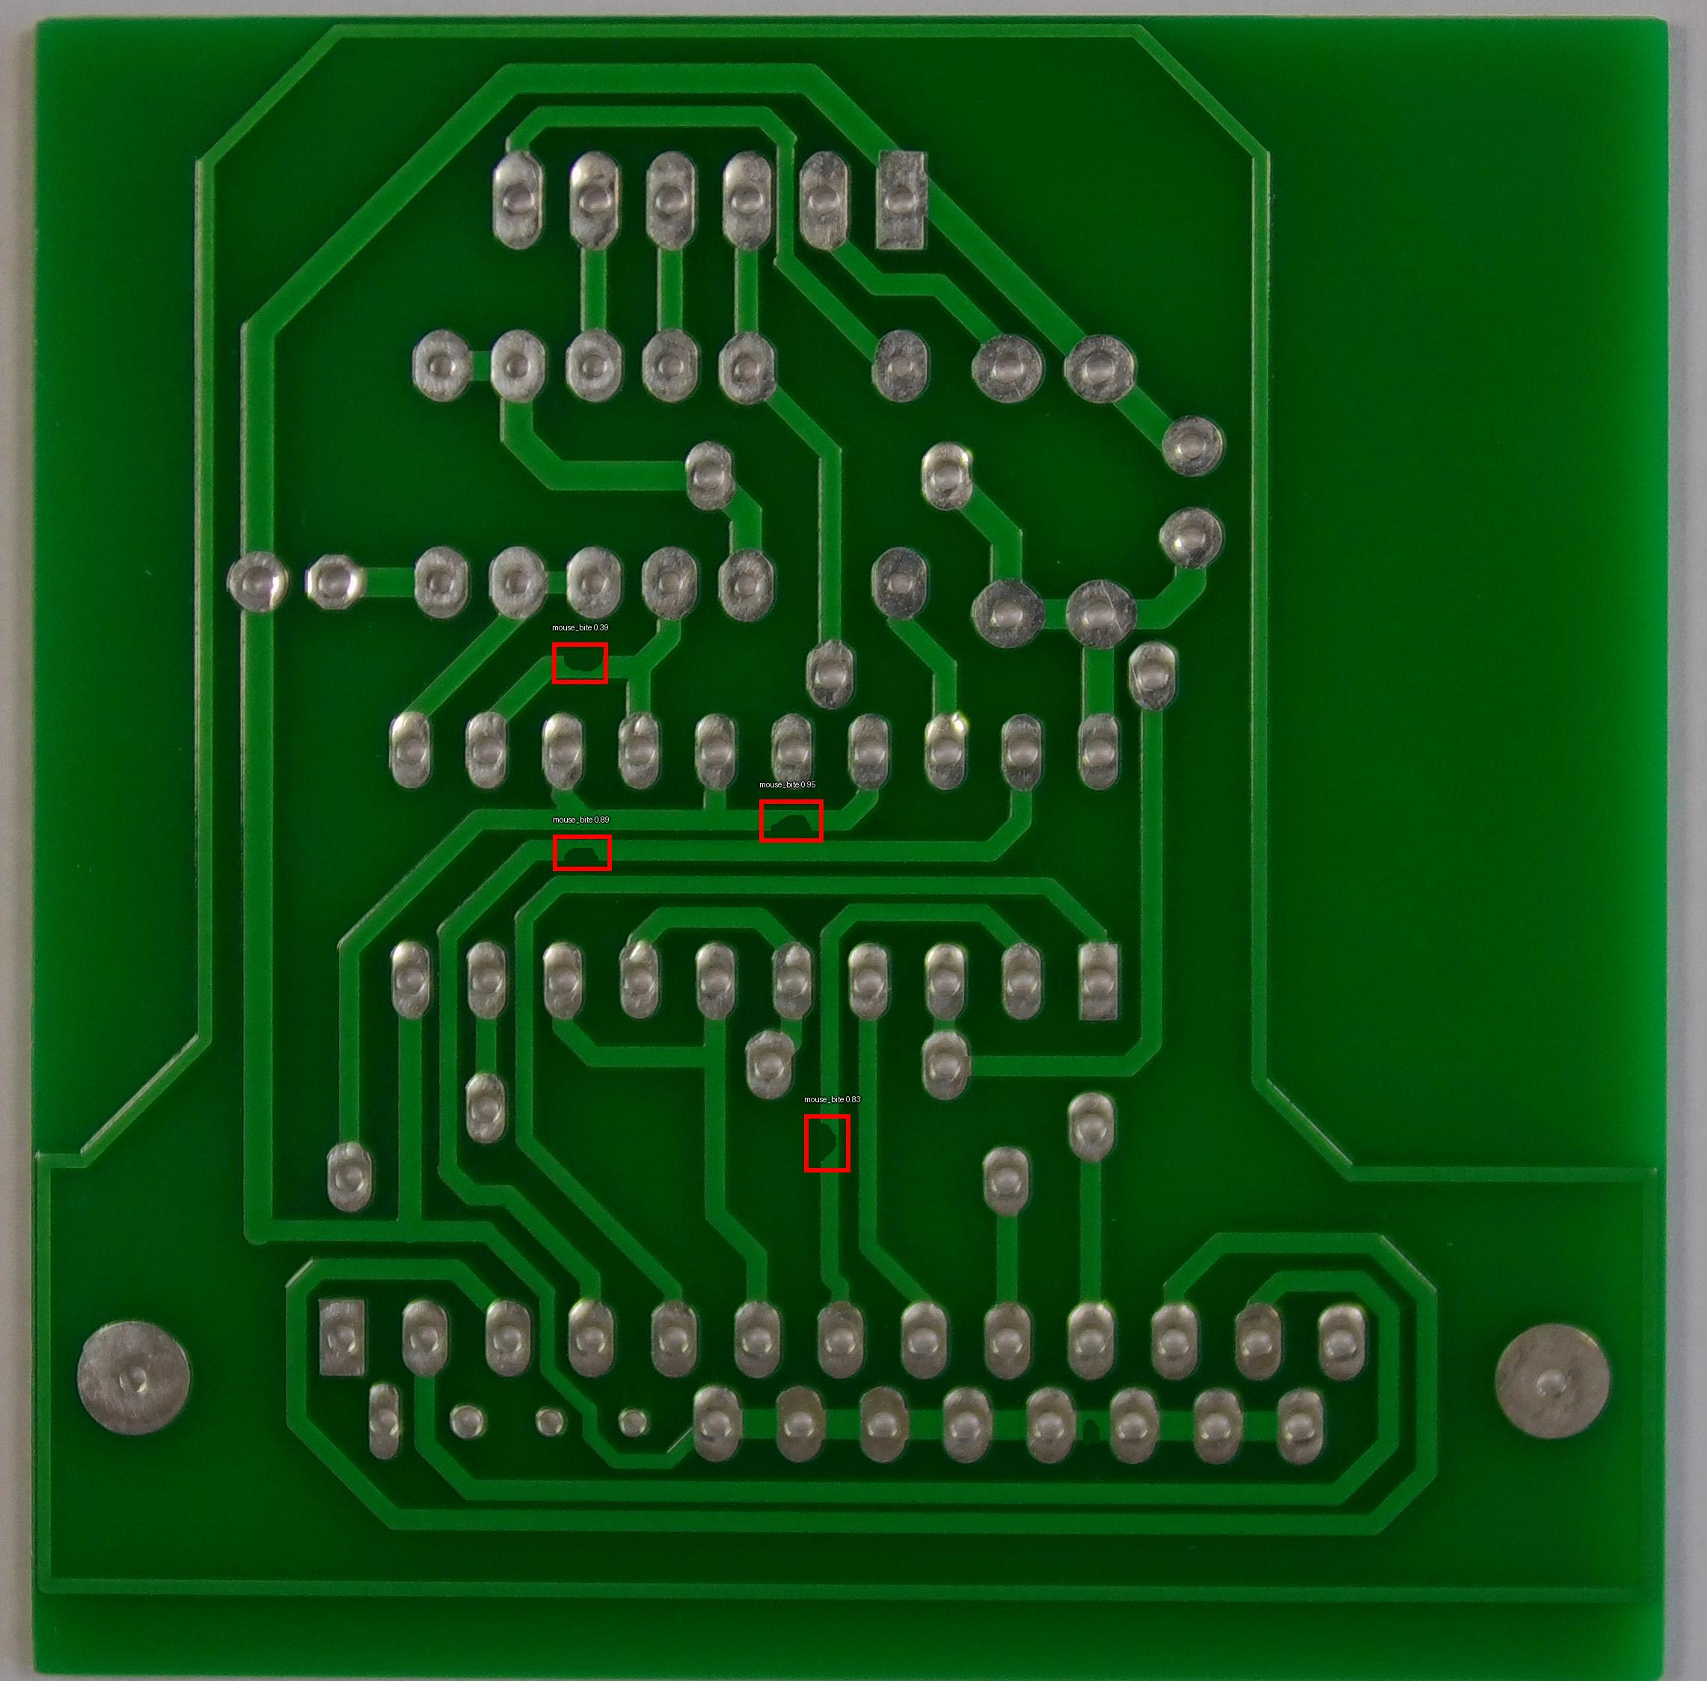
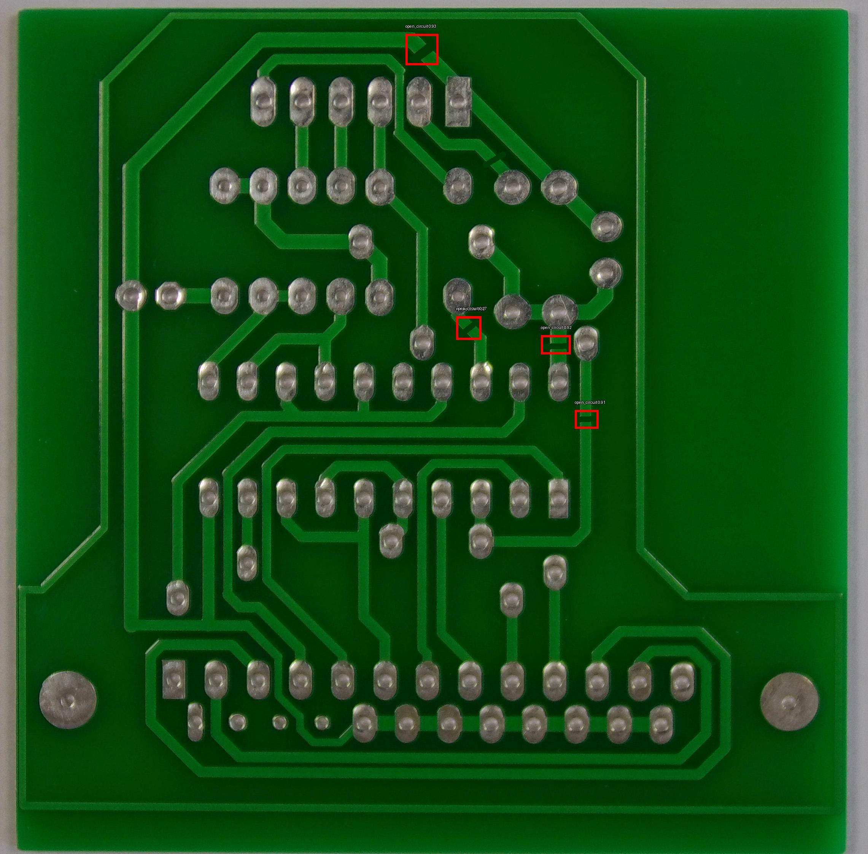
Detected Images
Missing_Hole Mouse_Bite Open_Circuit

Slide 13

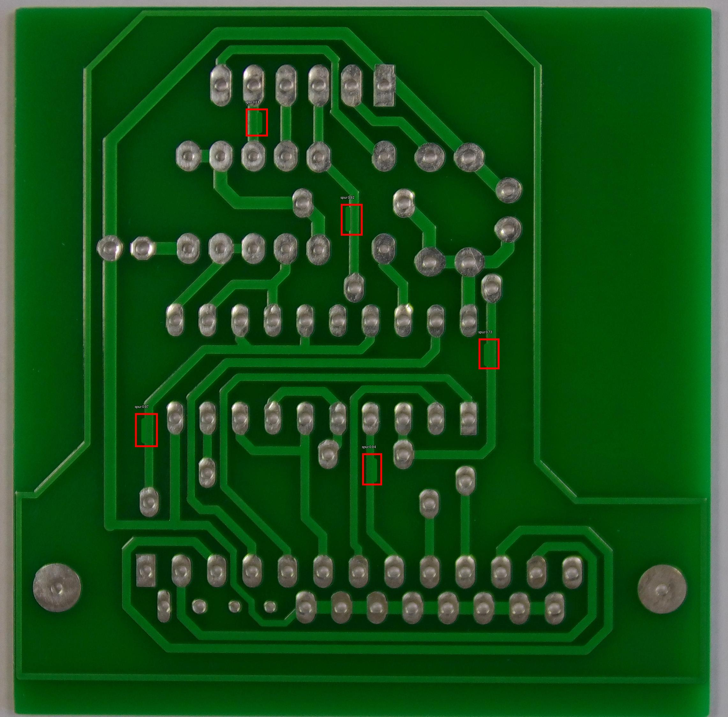
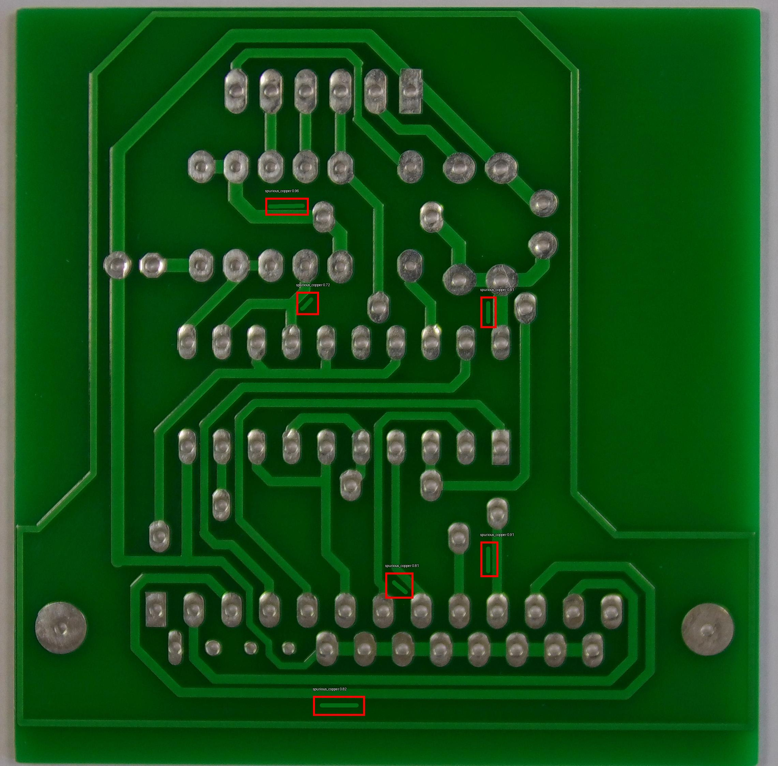
Detected Images
Short Spur Spur_Copper

Slide 14
Key Code Highlights
Dataset prep (Milestone 1): resize + threshold + subtract + contour crop
YOLO prep & training (Milestone 2)
model = YOLO('yolov8n.pt’)
model.train(data='pcb.yaml', epochs=80, imgsz=640)

Slide 15
Milestone 3 : Web Application – Streamlit UI
Features:
Upload PCB image (.jpg/.png)
Real-time YOLOv8 detection
Side-by-side: Original vs Annotated
Defect table (class + confidence)
Download annotated image
Style: Thick red boxes (width=10), large bold white labels with black outline

Slide 16
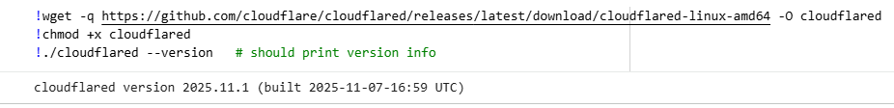

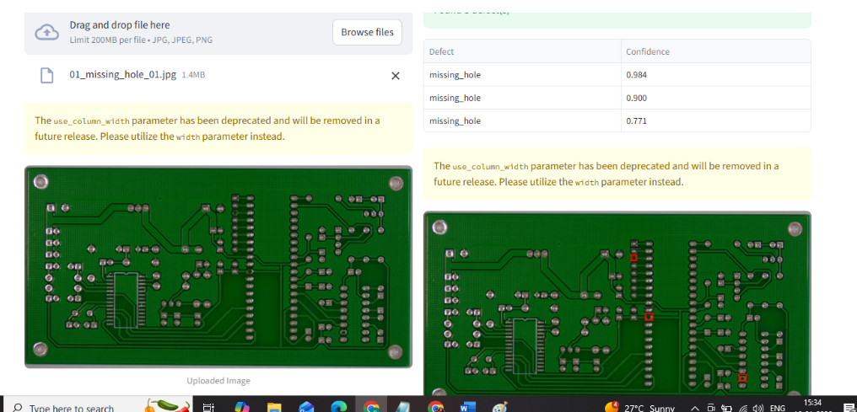
Results

Slide 17
Conclusion
Conclusion:
Successful end-to-end system: CV + DL + Web UI
High accuracy & practical deployment
Meets all project objectives

